Slide 1

E-Waste
Management
Step Towards a Clean Earth

Slide 2

E-Waste Management System
Presented By
Under The Guidence of
Sribas Das Mahapatra ( 2513 )
Kritish Shaw ( 2515 )
Riju Pal ( 2516 )
Rahul Molla ( 2560 )
Mrs. Arunita Das
Faculty Member
Department of BCA
Midnapore College
( Autonomous )

Slide 3
CONTENT
Introduction
Our Objectives
Motivation of The Project
Literature Survey on Related Works
Scope of The Work
Work Flow Diagram
ER Diagram
Data flow Diagram
Results
Profit Model & Rewards Points
Conclusion
Limitations
Future Work
References

Slide 4
INTRODUCTION
What is E-Waste ?
E-waste means electrical and electronic equipment, whole or in part discarded as waste by the consumer or bulk consumer as well as rejects from manufacturing, refurbishment and repair processes.
Type of E-Waste
E-Waste and Environmental Effect
E-Waste Management System

Slide 5
OUR OBJECTIVE
Our main objectives are given below: -
Focus on E-Waste Only
Location Tracking
Coverage in Rural Areas
Reward in exchange of E-Waste
Ease of Waste Pick up
Educating The User

Slide 6


MOTIVATION OF THE PROJECT
E-waste is the “fastest growing waste stream in the world”.
In 2018 an estimated 50 million tons of e-waste was reported, thus the name “Tsunami of E-waste” given by UN.
In 2019 an enormous volume of e-waste(53.6 Metric ton with 7.3kg per capita average) was generated globally.
The Confederation of Indian Industry (CII) organized a virtual
conference on “E-Waste Management in India 2020”.
https://www.cii.in/
India ranks fifth amongst the largest e-waste producing countries.

Slide 7
Application Name | Features | Technology Used | Limitations
[1] Praan Vaayu e-waste management (Author – Arth Technology - India): | Sign in process Collection Procedure Form Fill up for new customer Access to Collection History | Android Studio Kotlin Xml | No OTP Verification No Location Tracking mechanism. No support page. Less E waste options
[2] UZED – Recycle plastic, e-waste (Rapidue Technologies Pvt. Ltd.): | Multi-City feature Impact and Reward Options Categories of E-waste Customer Support | Android Studio Java / kotlin xml | Availability No Location tracking No doorstep service.
[3] i899 Recycling – E-Waste Recycle (Spas Group of Companies): | E-Waste Pickup Service Barcode-Scanning Feature Reward tracking System Step by step packaging guide | Android Studio Java / Kotlin Xml Firebase Data Base | Privacy Issue
[4] Zolopik E-Waste Recycling (Author – Zolopik E-Waste Recycling Trivendent Technologies Pvt. Ltd.): | Web Application E-waste selling option. Coverage in Mega-city. Customer Support | HTML5, CSS, JavaScript PHP | No sign-up page Website not Dynamic Email-id is mandatory No Category-Wise Division.

Slide 8



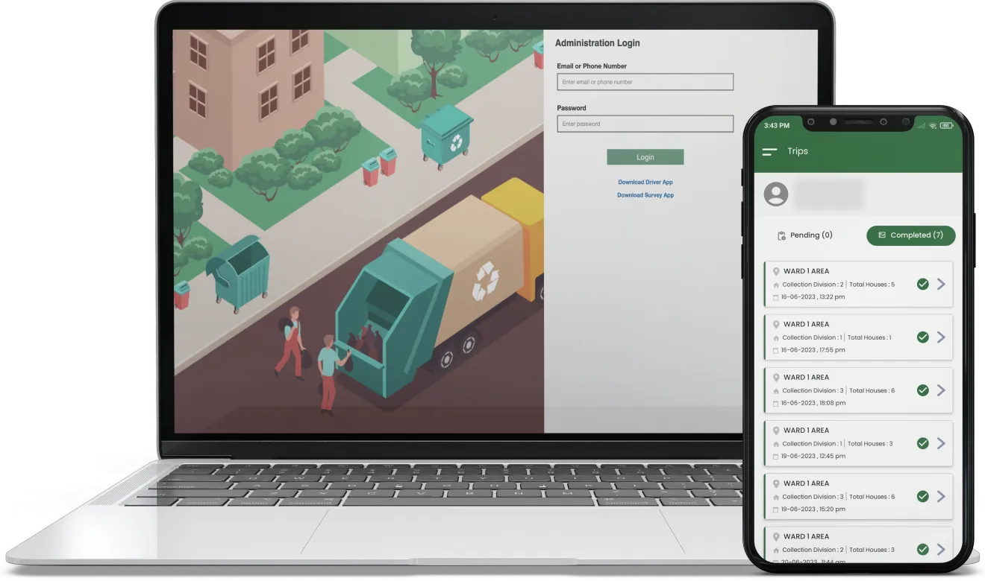

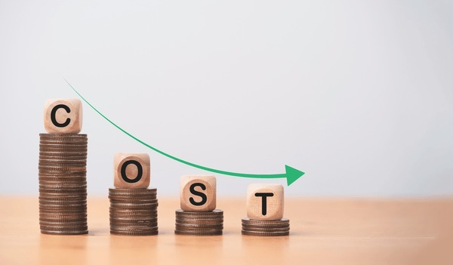
SCOPE OF THE WORK
On 19th May, 2022, Ministry of Environment, Forest and Climate Chane, Govt. of India published a draft rule, namely E-waste (Management) Rules.
Various Scope of the Project are given below –
Business Scope
Environment Friendly
Streamlining Waste Management Operations with Software
Enhanced Data Management and Reporting
Improved Efficiency and Cost Savings

Slide 9
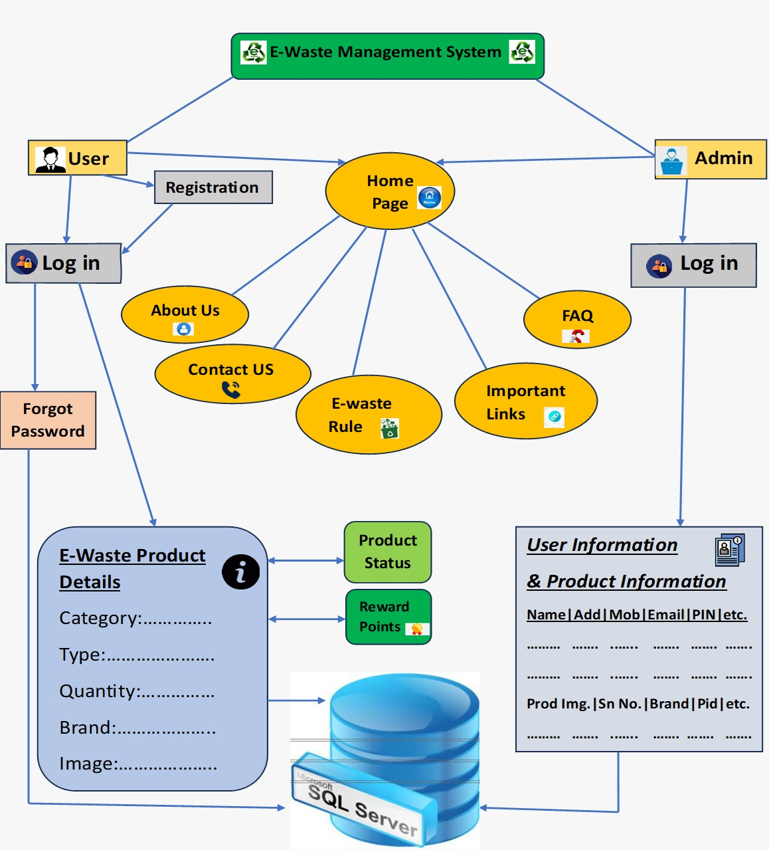
WORKFLOW DIAGRAM

Slide 10
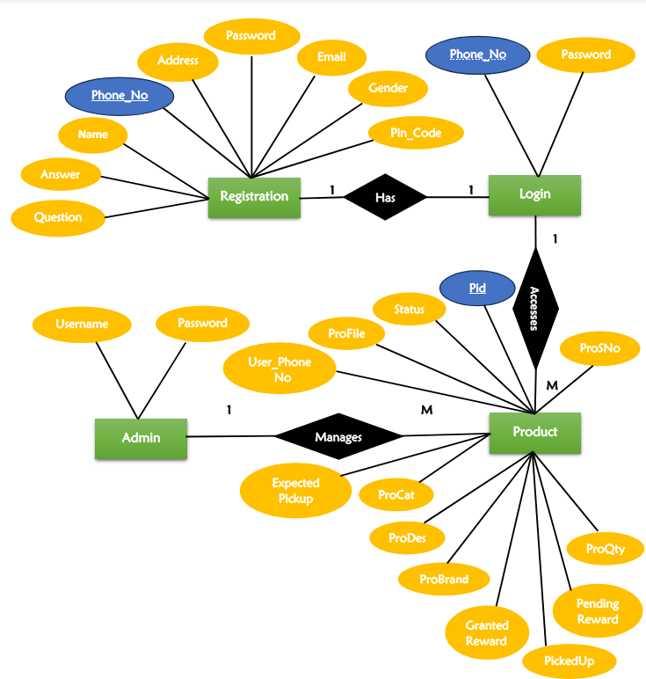
E-R Diagram:

Slide 11
Data Flow Diagram:

Slide 12
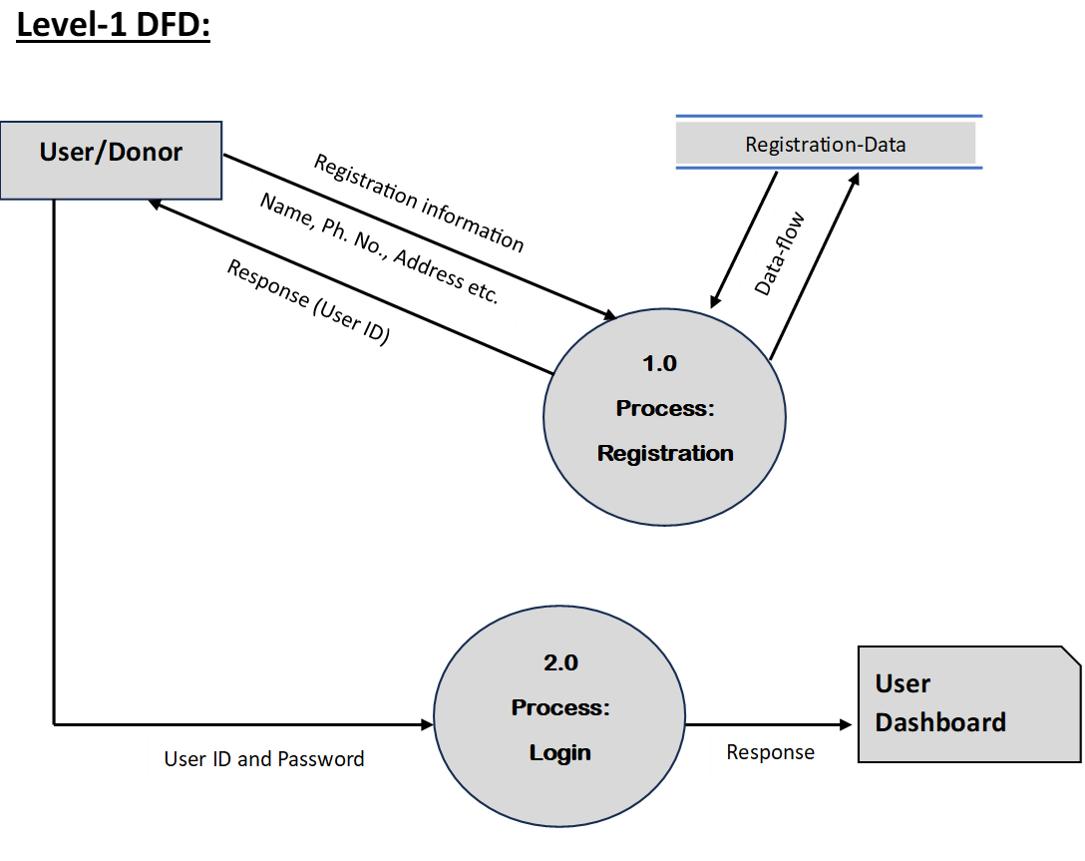
User view:

Slide 13
User view:

Slide 14
ADMIN VIEW

Slide 15
Admin View:

Slide 16
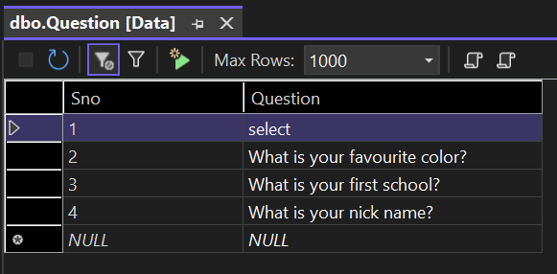
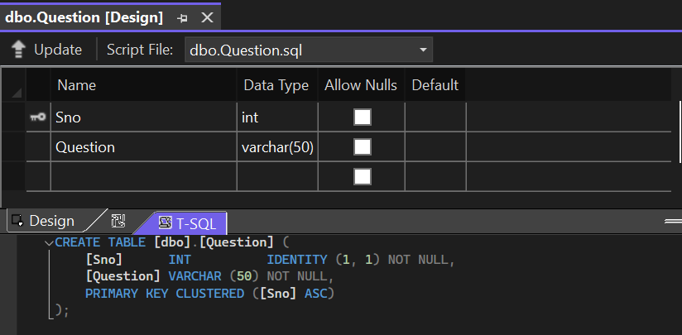
DATA TABLE AND ATTRIBUTES

Slide 17
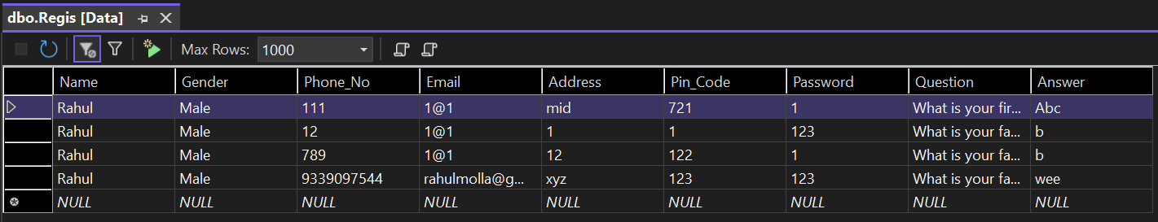
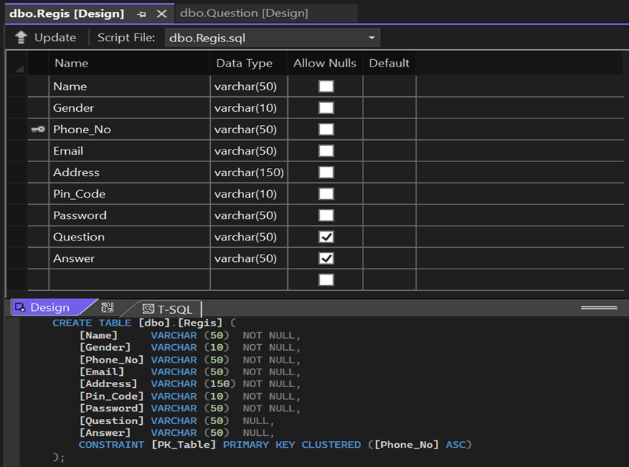
REGISTRATION DATABASE:

Slide 18
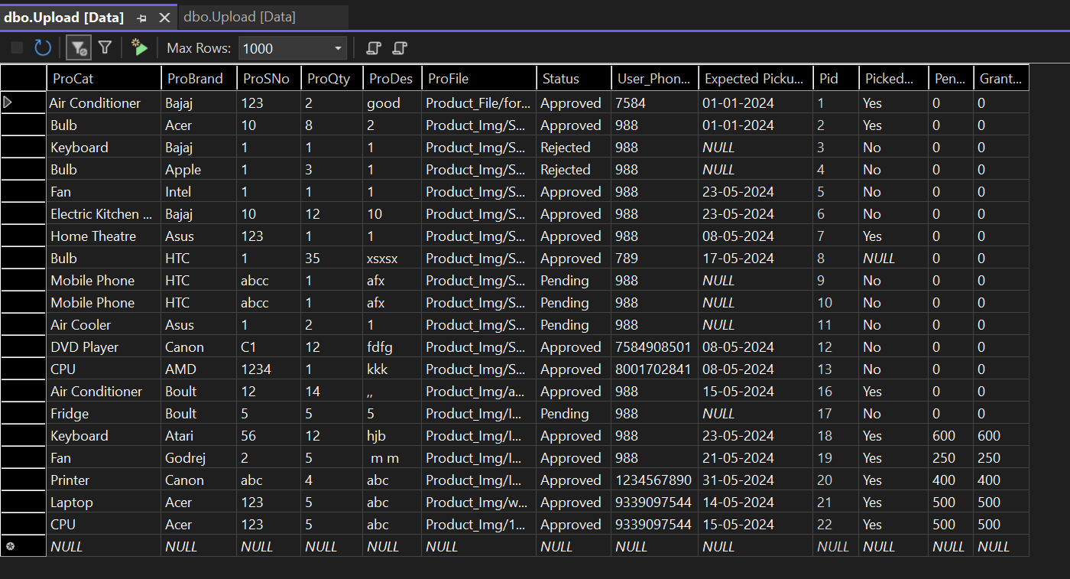
PRODUCT DATABASE:

Slide 19
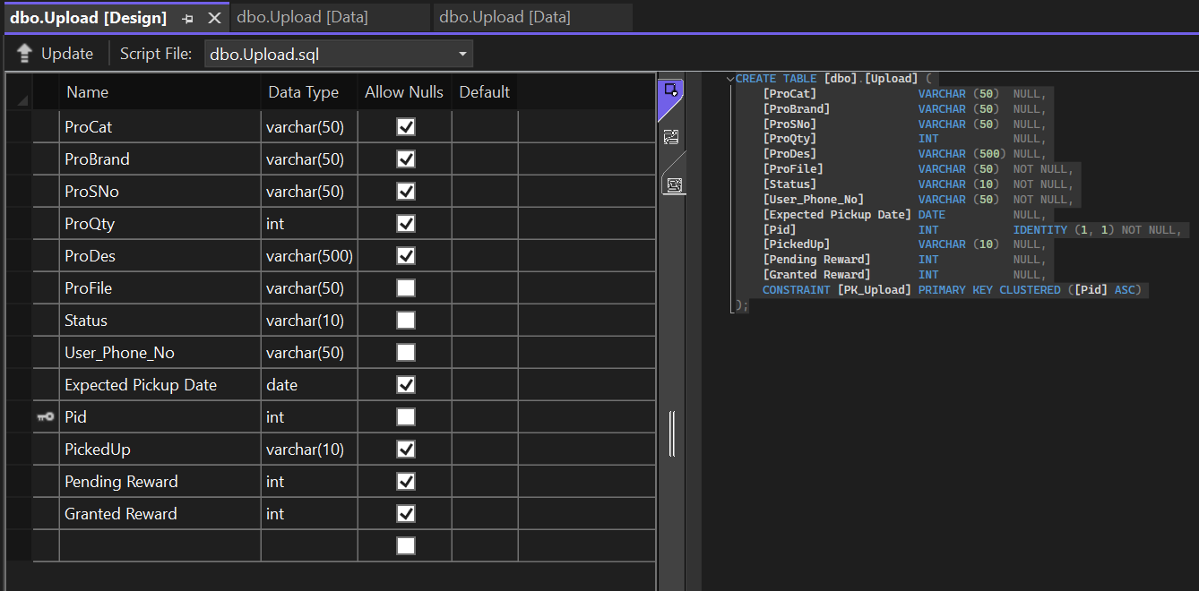

Slide 20
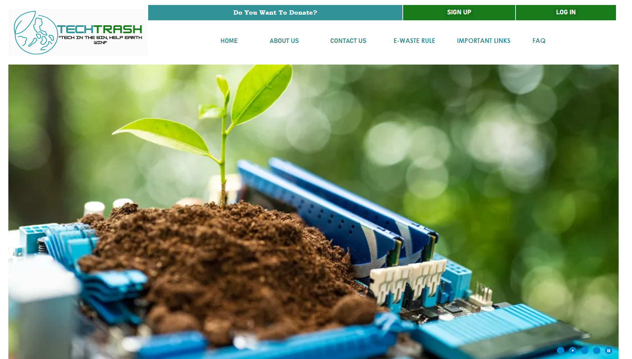
RESULT
((SNAPSHOTS OF WEB APPLICATION))

Slide 21
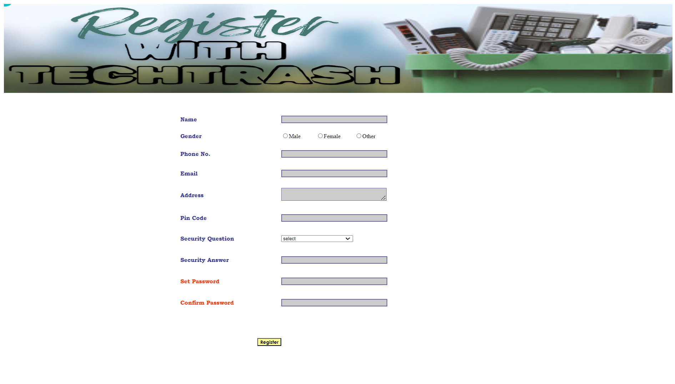
SIGN UP PAGE :

Slide 22
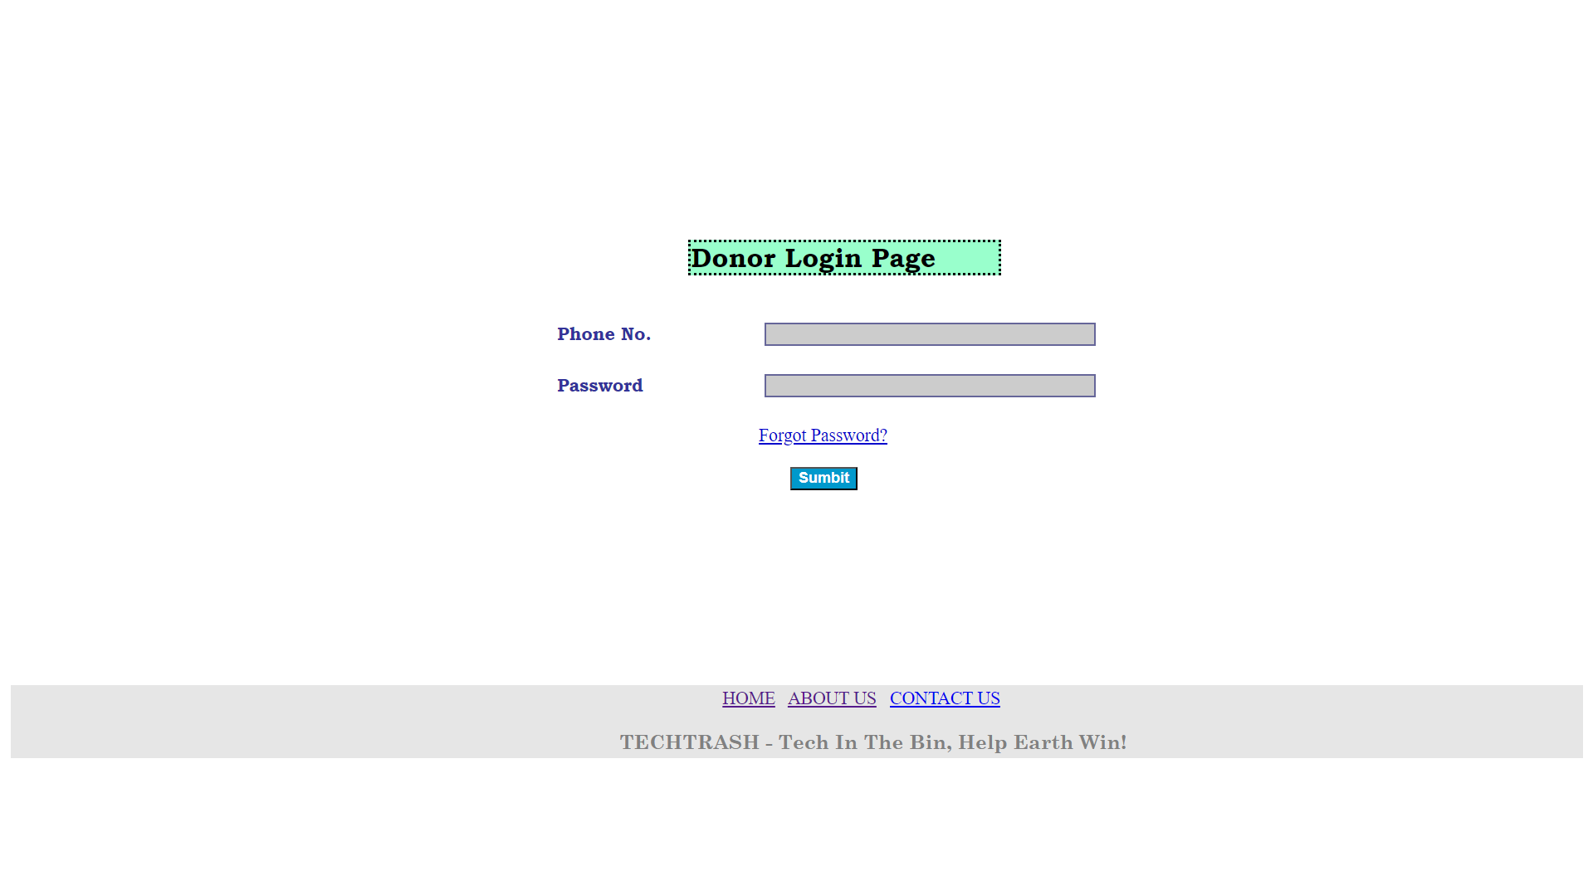
DONOR LOG-IN PAGE:

Slide 23
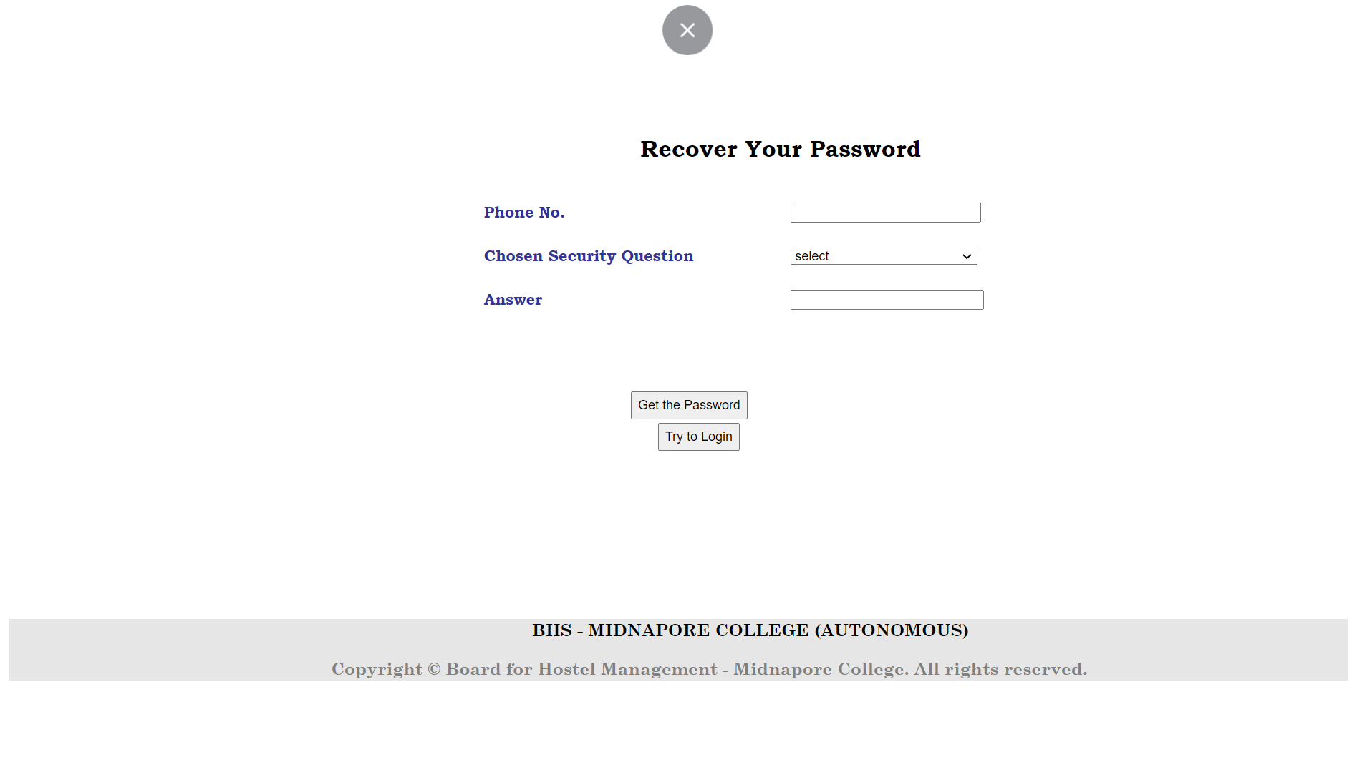
PASSWORD RECOVERY PAGE:

Slide 24
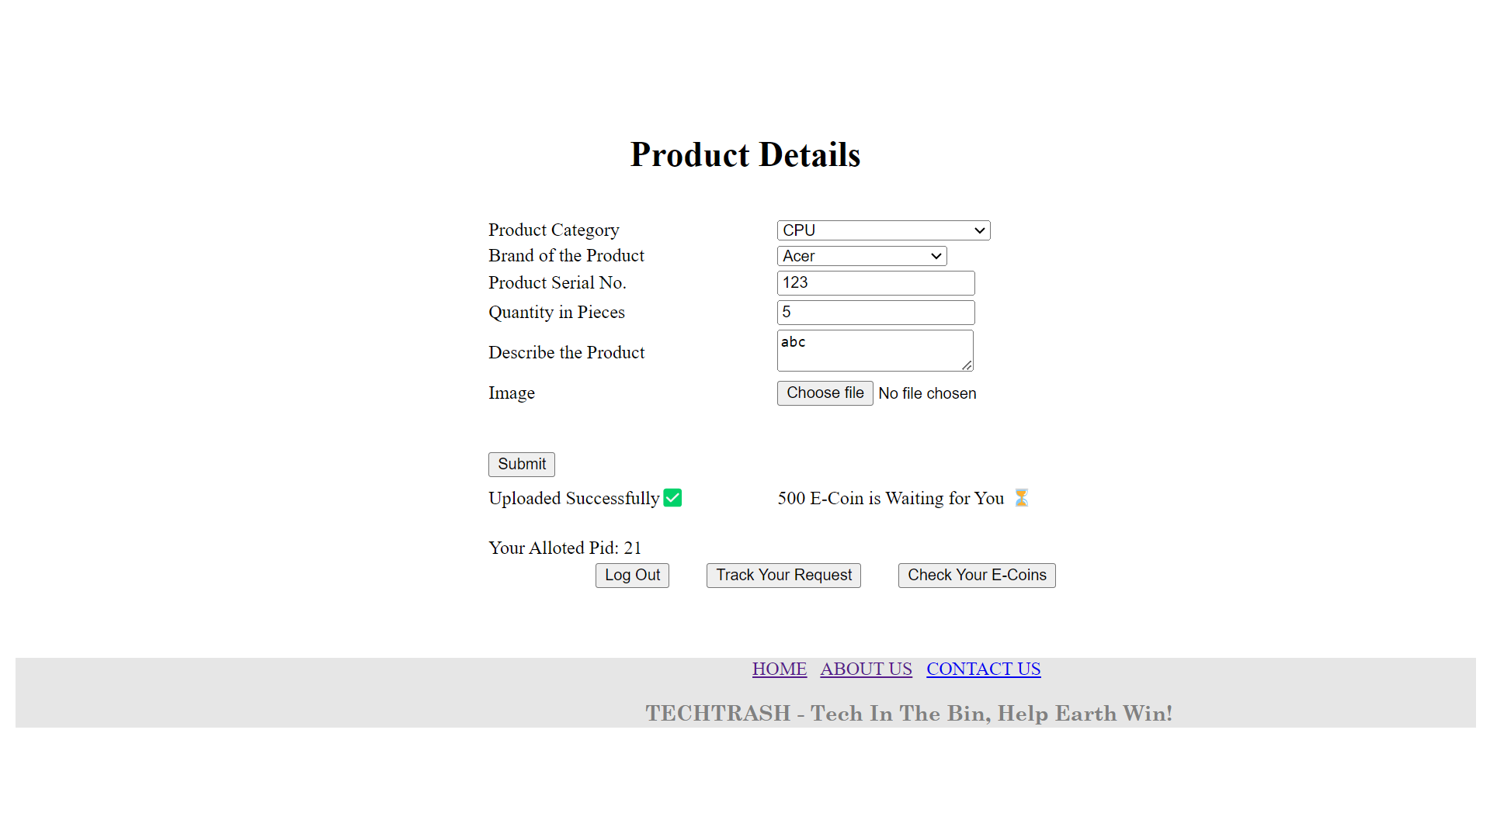
PRODUCT DETAILS:

Slide 25
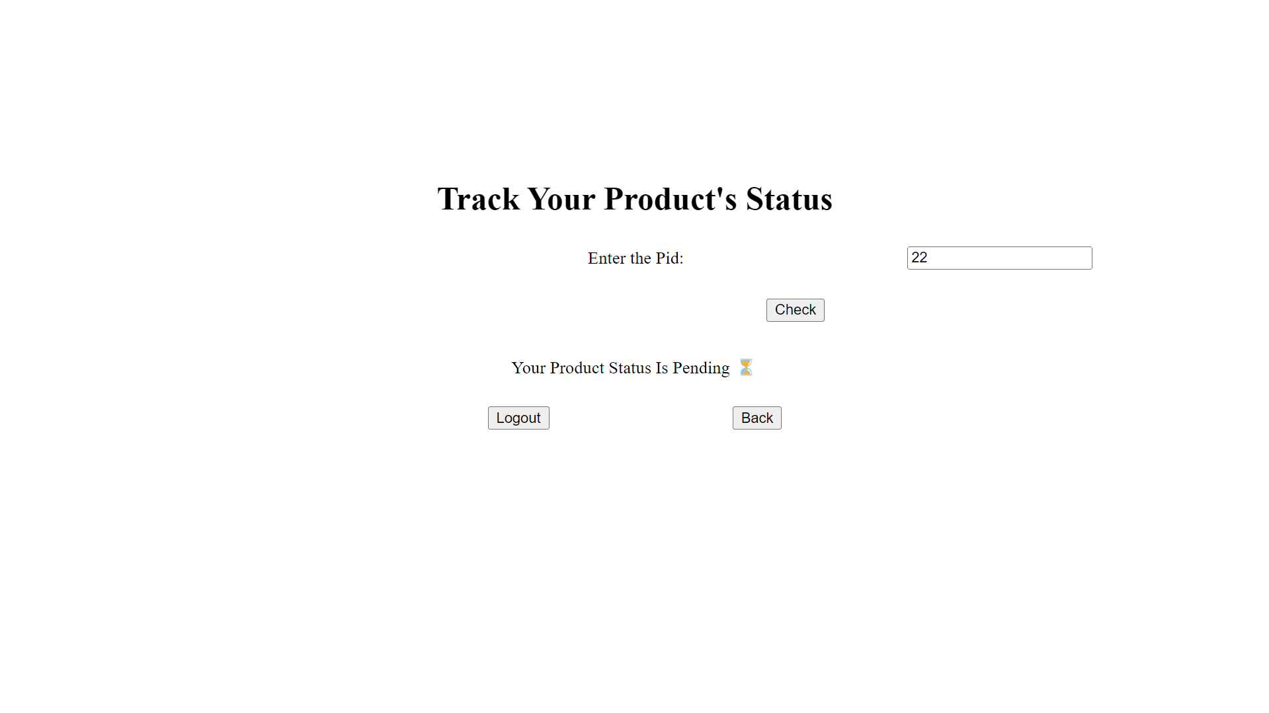
PRODUCT TRACKING:

Slide 26
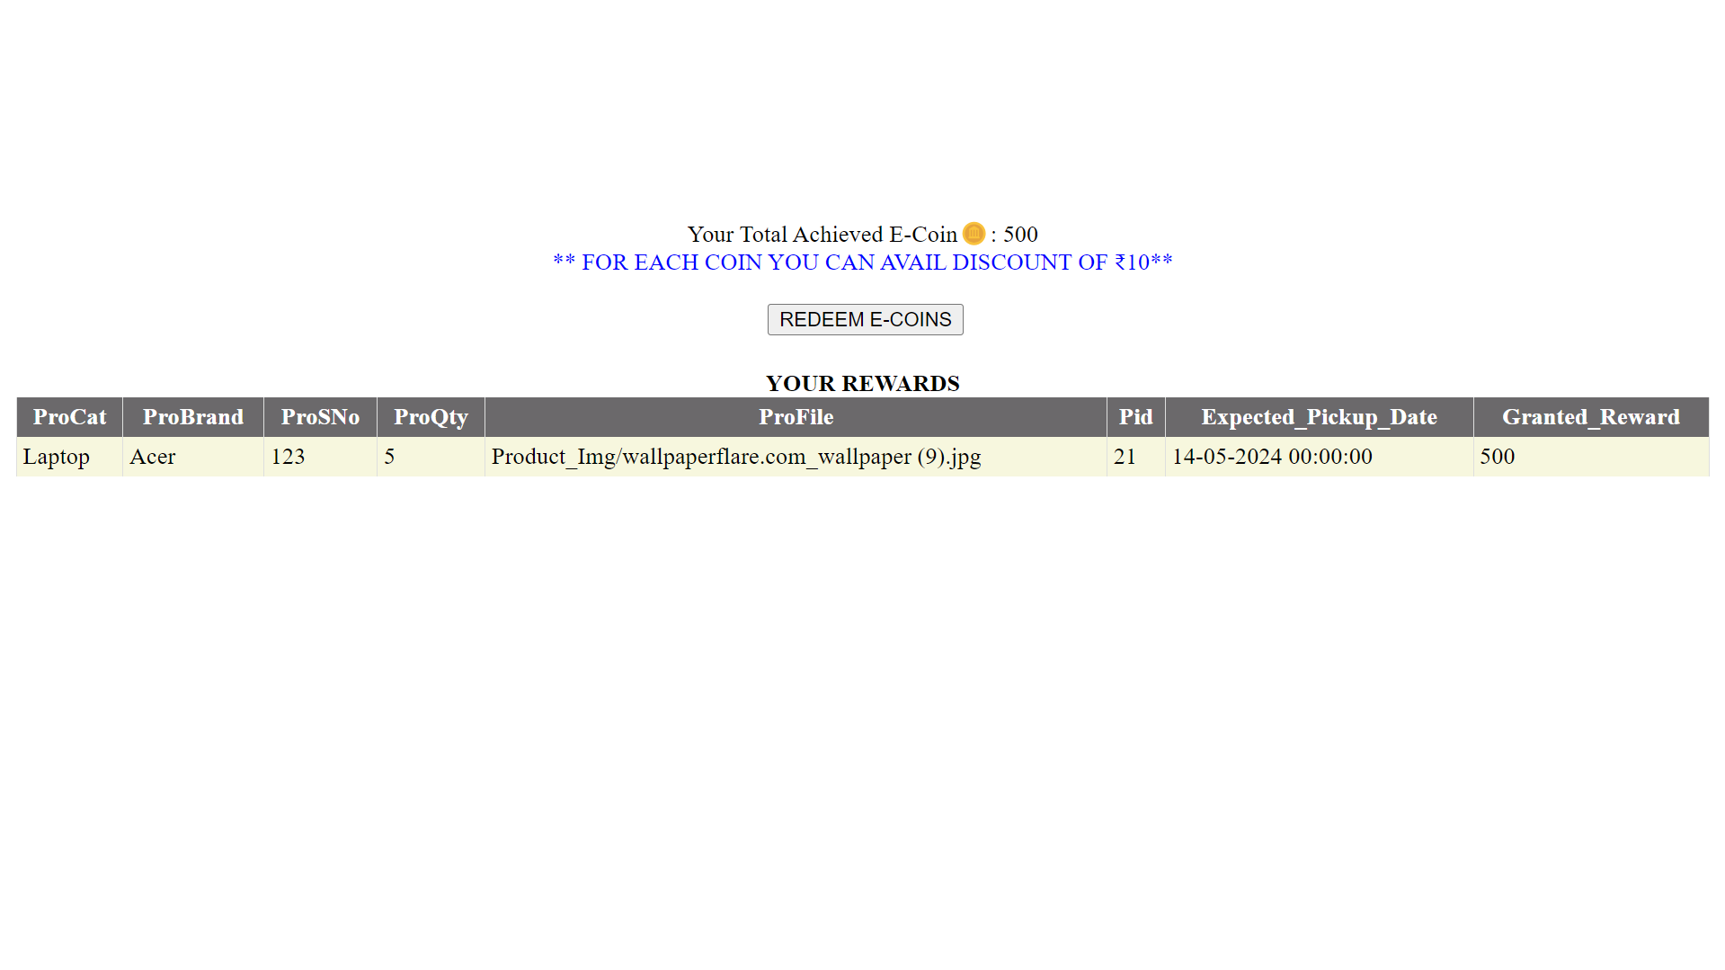
REWARD TRACKING:

Slide 27
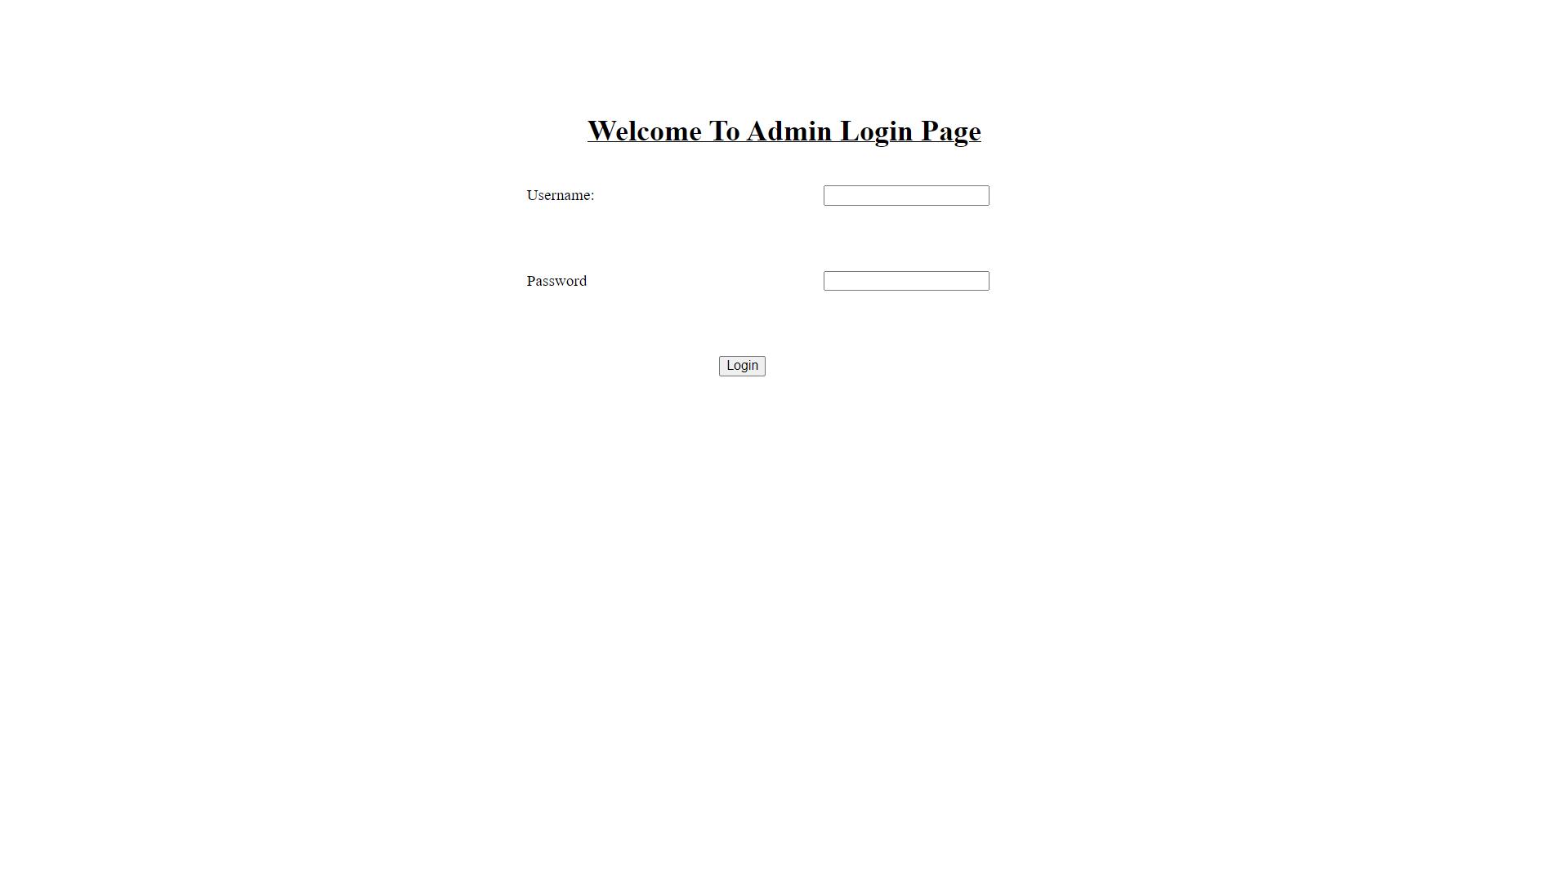
ADMIN LOGIN PAGE

Slide 28
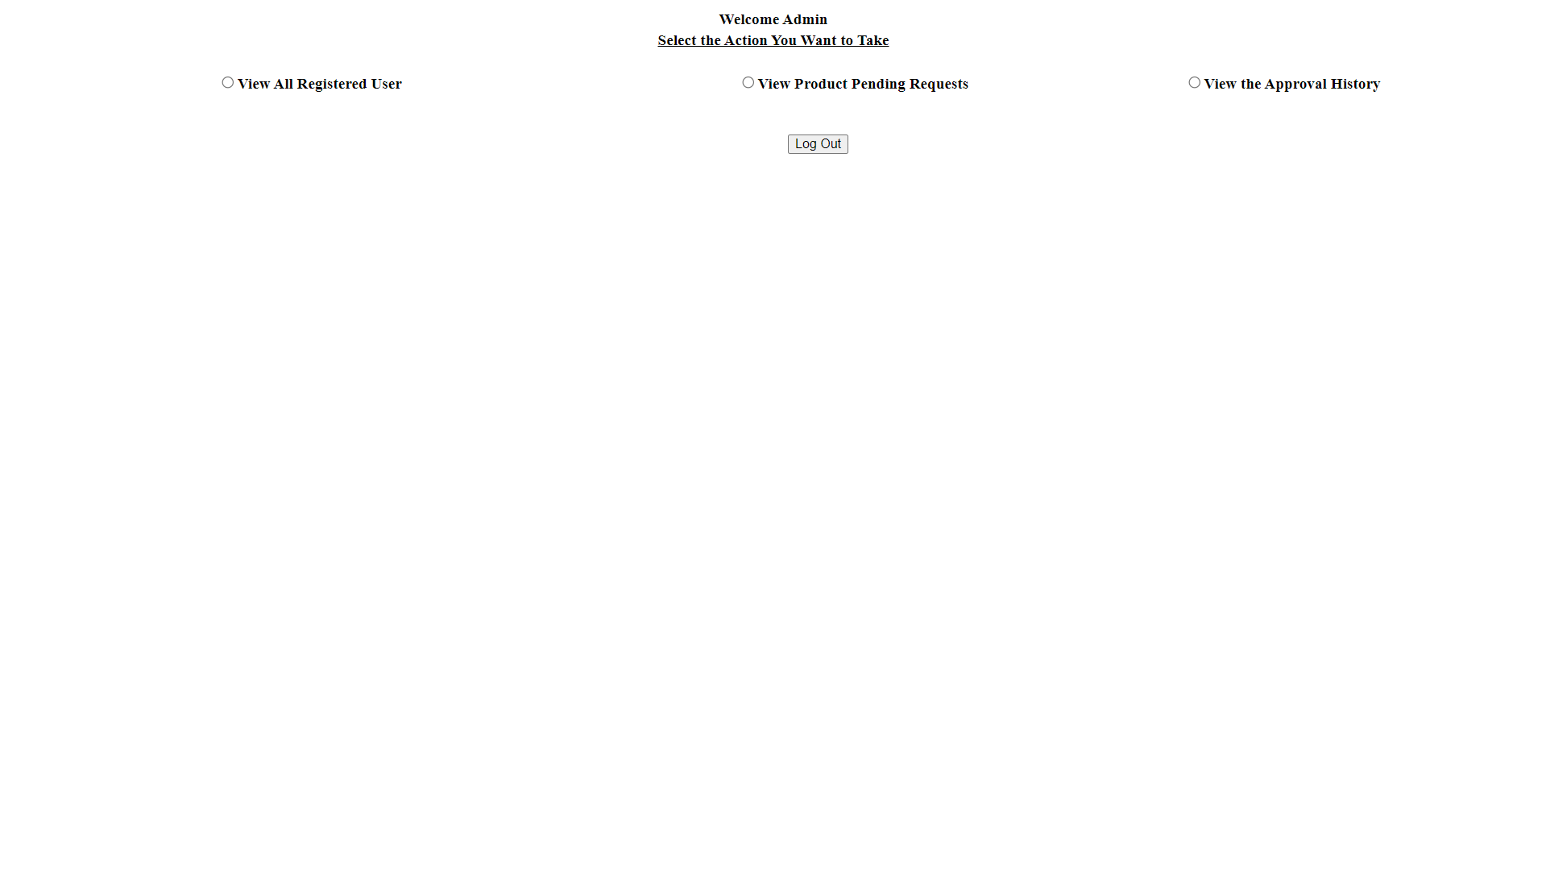
ADMIN DASHBOARD:

Slide 29
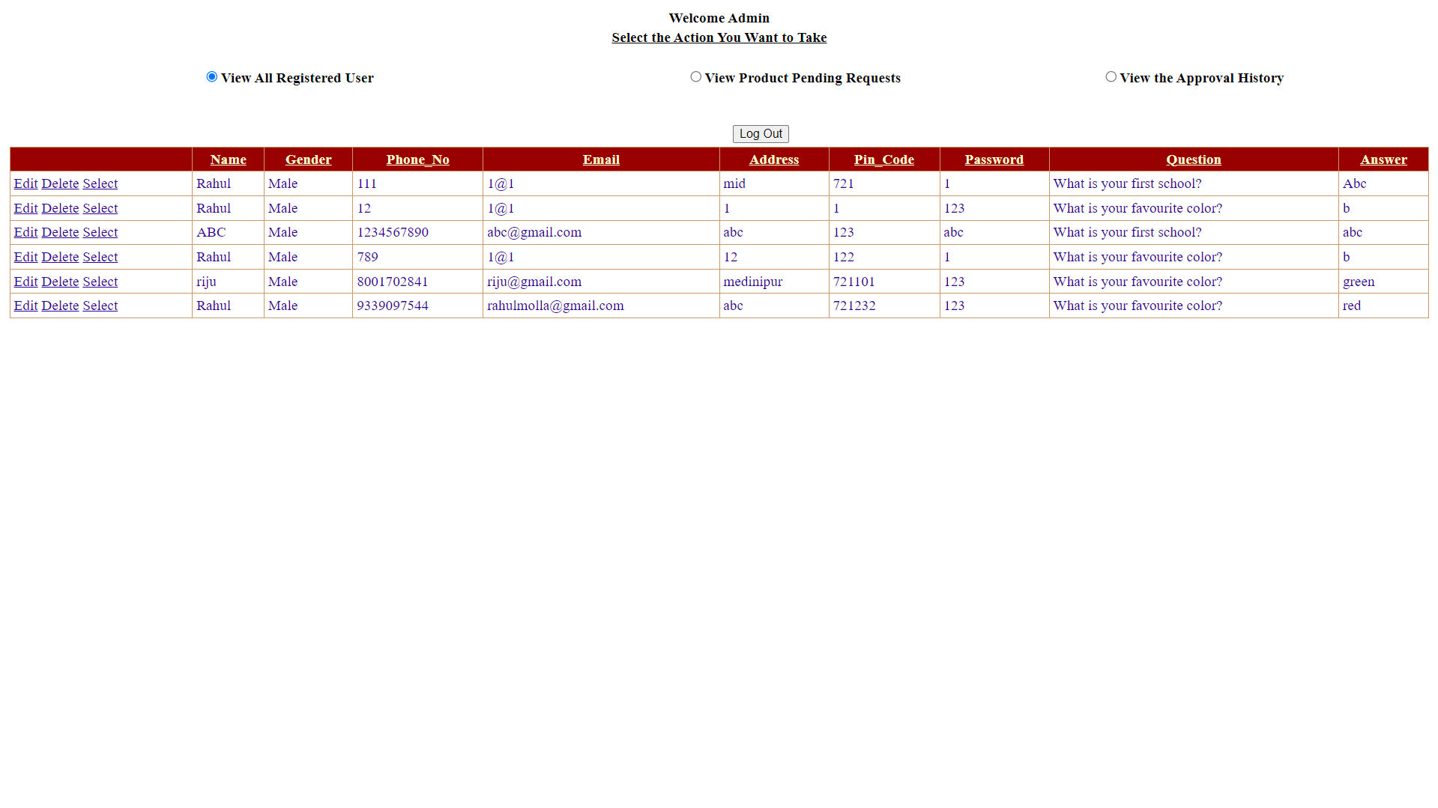
REGISTED USER DATA:

Slide 30
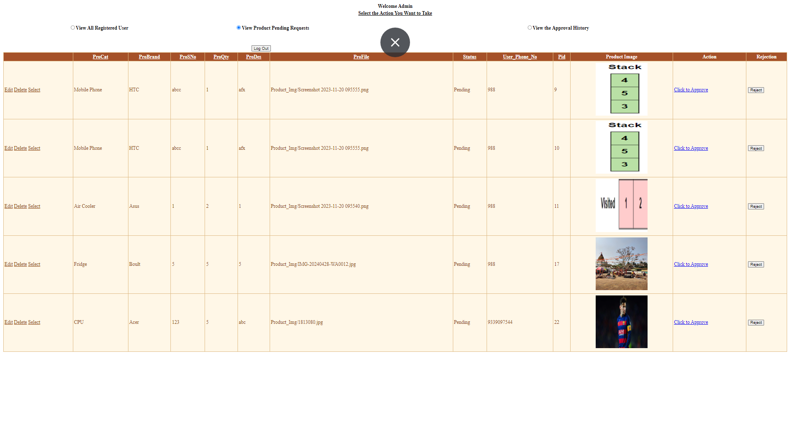
PENDING REQUEST:

Slide 31
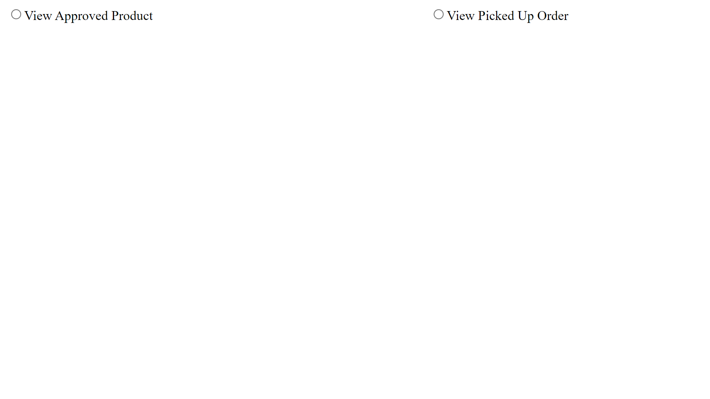
ORDER HISTORY:

Slide 32
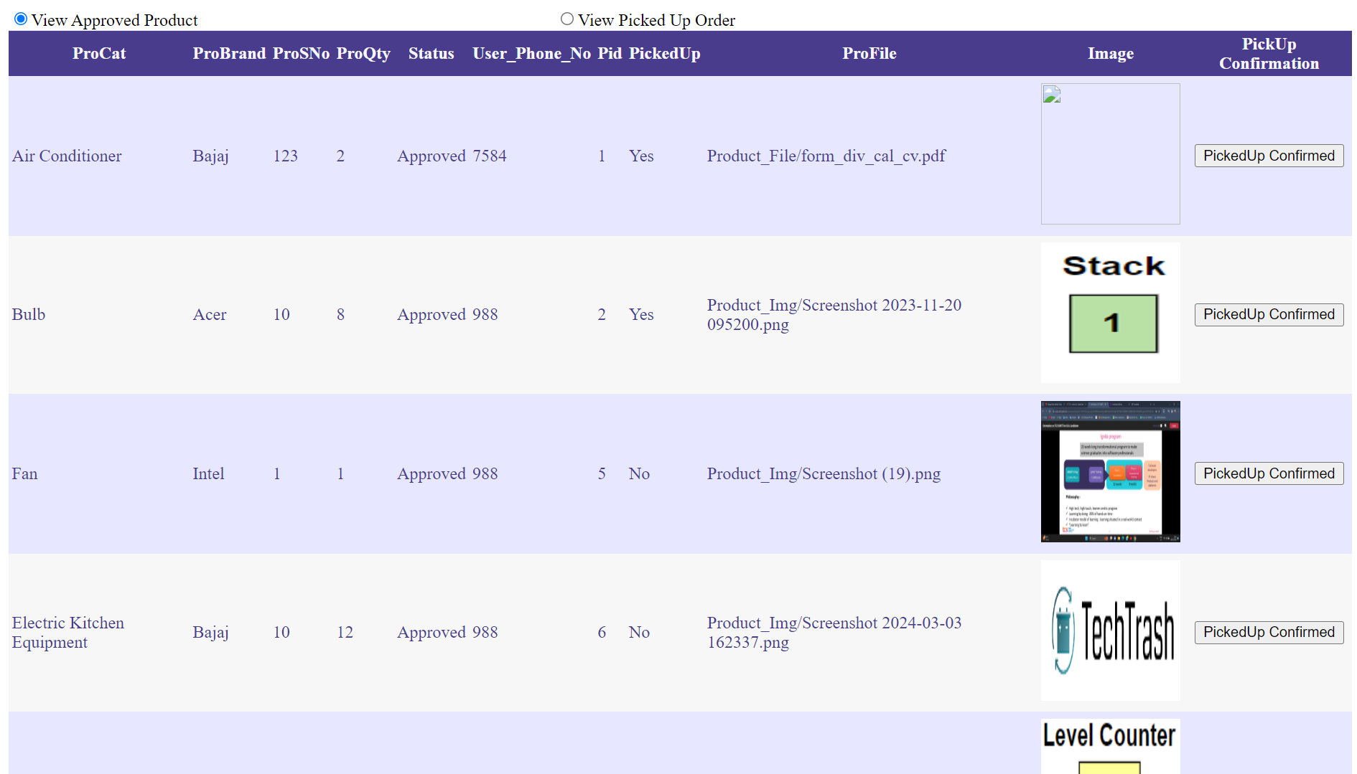
APPROVED PRODUCT:

Slide 33
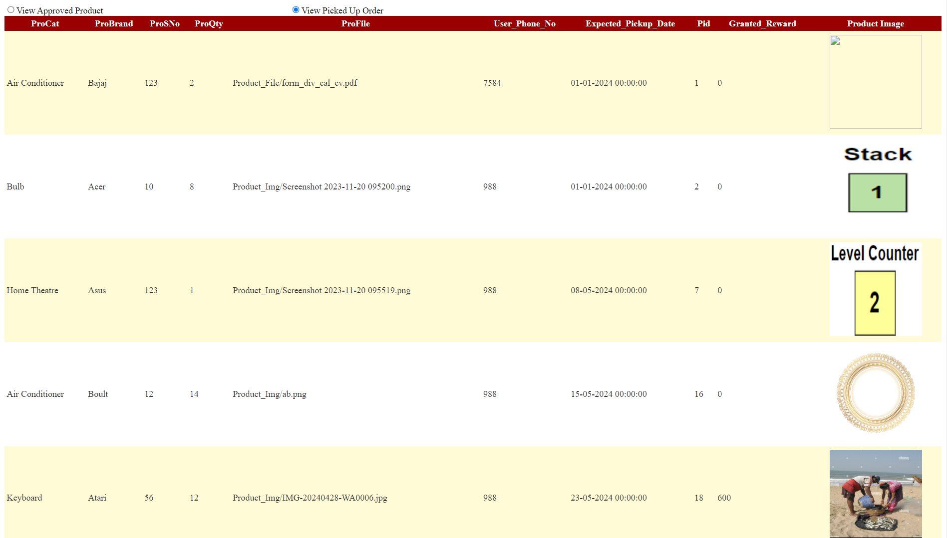
PICKED UP ORDER HISTORY:

Slide 34
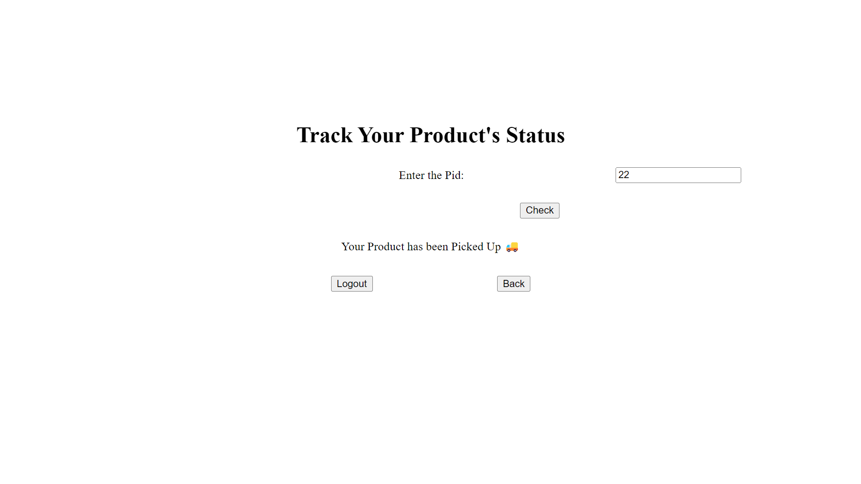
PRODUCT TRACKING:

Slide 35
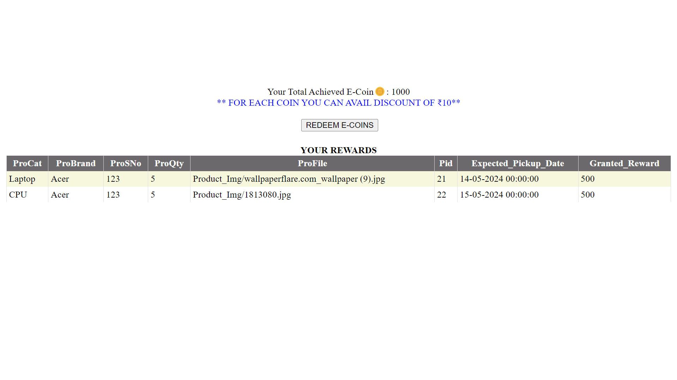
REWARD RECORDS

Slide 36
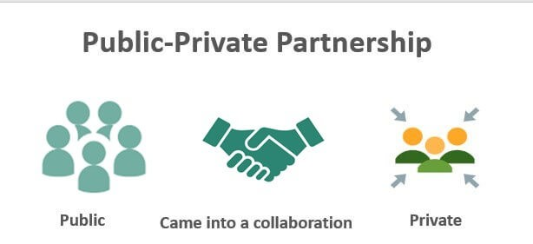
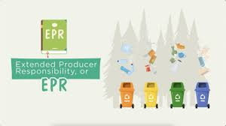
PROFIT MODEL
PPP (Public Private Partnership)
EPR (Extended Producer Responsibility Program)
Dismantling or auctioning the electronic parts and selling them to different industries
Refurbishing and Reselling
https://www.pppinindia.gov.in/ https://eprplastic.cpcb.gov.in/

Slide 37
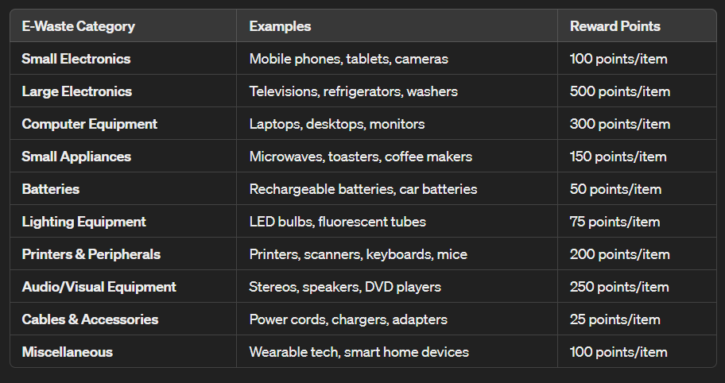
REWARDS POINTS

Slide 38
CONCLUSION
After analyzing and surveying some of the popular pre – existing E-Waste Management System projects in the market, we have come to the conclusion that there are some limitations to those projects which can further be solved by different approach. In reality, there are very little software application regarding e-waste management.
So, we have come with several ideas to tackle the problems with more optimized methods that are to be implemented in the project.

Slide 39
LIMITATIONS
E-mail or Mobile No. notifications is not available.
Location tracking through Google map is not available.
User have no option to pick option to pick up date as per availability.
User cannot redeem the rewards points.

Slide 40
FUTURE WORK
Our main plan to overcome the limitations and implement all possible
features in our application. Here, our future working methods are described below-
1. We will develop a comprehensive feature list for the e-waste Management
System App based on the literature survey and user needs.
2. We will try to fulfil our objectives mentioned above through development of this
Application.
3. We will provide a user-friendly and intuitive interface for data entry, e-waste
selling and reporting, ensuring that users can easily input information about
their e-waste disposal and recycling activities.
4. We will implement more features for tracking and monitoring e-waste
collection and recycling efforts, providing users with real-time updates on their
environmental impact.
5. Refine the app based on user feedback and conduct further testing to ensure a
seamless user experience.

Slide 41
REFERENCES
[1] Praan Vaayu e-waste management (Author – Arth Technology - India):
https://play.google.com/store/apps/details?id=com.praanva ayu.ewaste
[2] UZED – Recycle plastic, e-waste (Author –Rapidue Technologies Pvt. Ltd.):
https://play.google.com/store/apps/details?id=com.rapidue. uzed
[3] i899 Recycling – E- waste Recycle (Author – Spas Group of Companies):
i899 Recycling- E-waste Recycl - Apps on Google Play
[4] Zolopik E-Waste Recycling:
https://www.zolopik.com/

Slide 42
Thank You

